Slide 1

Machine learning course
Presented by Abdel Rahman AlSabbagh
FINAL Lecture #6 – Sat – 27.5.2023

Slide 2


Tech Requirements
In the name of Allah, the most gracious, the most merciful, we start :)
Machine Learning Course
Abdel Rahman AlSabbagh

Slide 3
Tech Requirements
Today’s Quote
“The winds of change may blow away everything in their path, but the lingering effect remains, shaping the landscape of our lives.”
- ChatGPT
Machine Learning Course
Abdel Rahman AlSabbagh

Slide 4
Tech Requirements
Support Vector Machines
Support Vector Machines (SVMs).
Kernel Functions.
Decision trees.
Random forests.
Ensemble learning.
Evaluation metrics.
Code practice.
Source: StatQuest by Josh Starmer.
Machine Learning Course
Abdel Rahman AlSabbagh

Slide 5
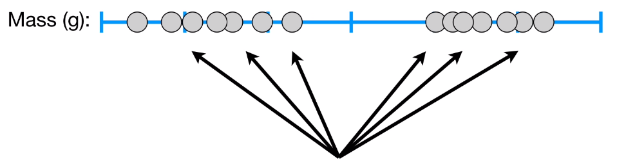
Tech Requirements
Support Vector Machines
Machine Learning Course
Abdel Rahman AlSabbagh

Slide 6
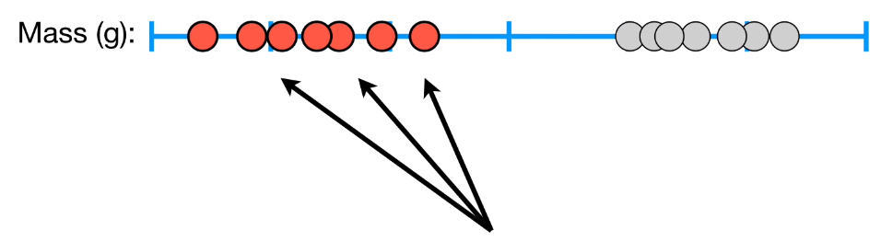
Tech Requirements
Support Vector Machines
Machine Learning Course
Abdel Rahman AlSabbagh

Slide 7
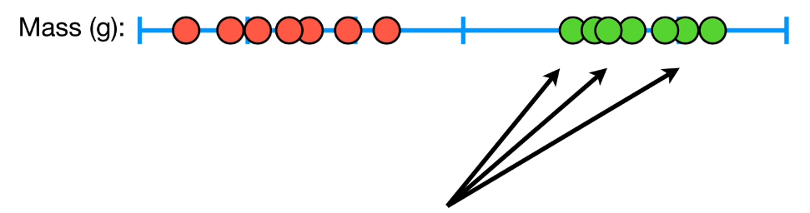
Tech Requirements
Support Vector Machines
Machine Learning Course
Abdel Rahman AlSabbagh

Slide 8
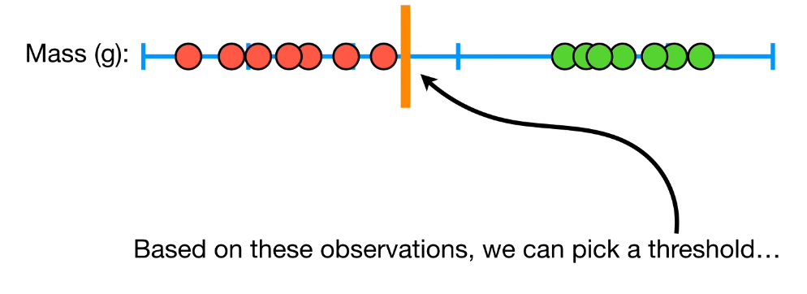
Tech Requirements
Support Vector Machines
Machine Learning Course
Abdel Rahman AlSabbagh

Slide 9
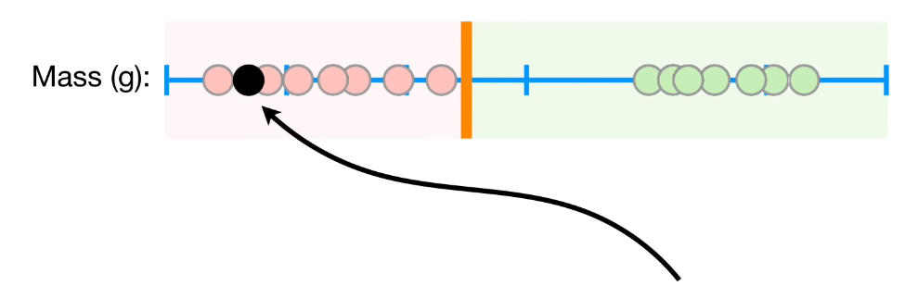
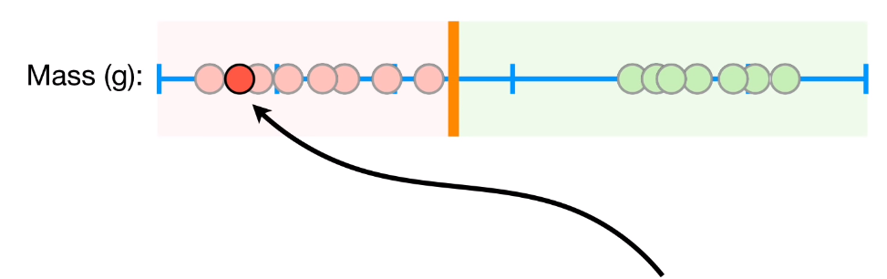
Tech Requirements
Support Vector Machines
Machine Learning Course
Abdel Rahman AlSabbagh

Slide 10
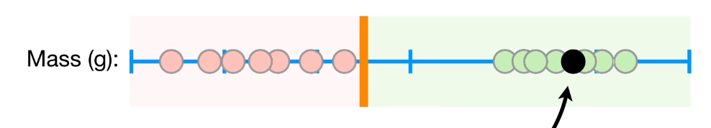
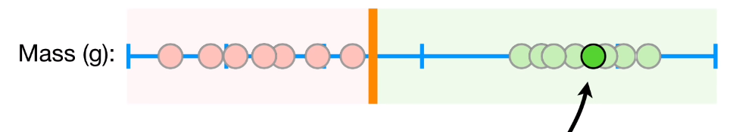
Tech Requirements
Support Vector Machines
Machine Learning Course
Abdel Rahman AlSabbagh

Slide 11
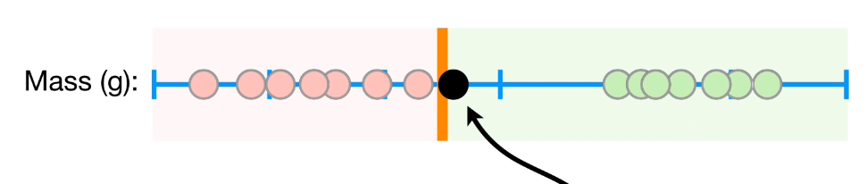
Tech Requirements
Support Vector Machines
Machine Learning Course
Abdel Rahman AlSabbagh

Slide 12
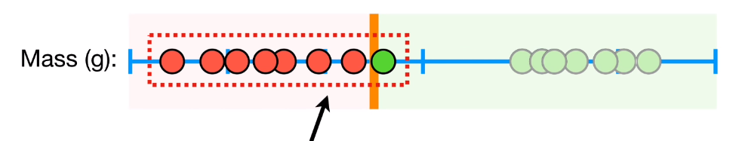
Tech Requirements
Support Vector Machines
Machine Learning Course
Abdel Rahman AlSabbagh

Slide 13
Tech Requirements
Support Vector Machines
Machine Learning Course
Abdel Rahman AlSabbagh

Slide 14
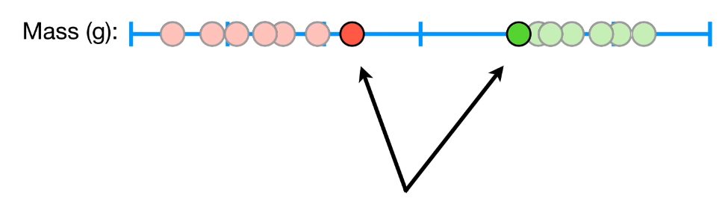
Tech Requirements
Support Vector Machines
Machine Learning Course
Abdel Rahman AlSabbagh

Slide 15
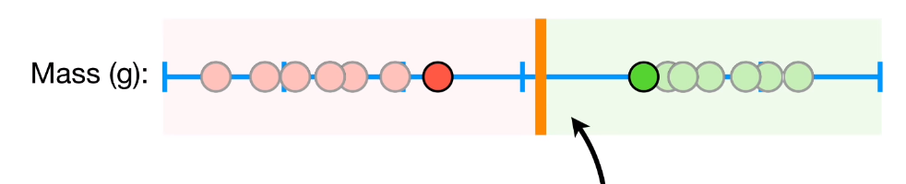
Tech Requirements
Support Vector Machines
Machine Learning Course
Abdel Rahman AlSabbagh

Slide 16
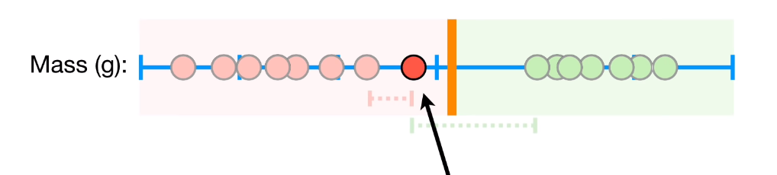
Tech Requirements
Support Vector Machines
Machine Learning Course
Abdel Rahman AlSabbagh

Slide 17
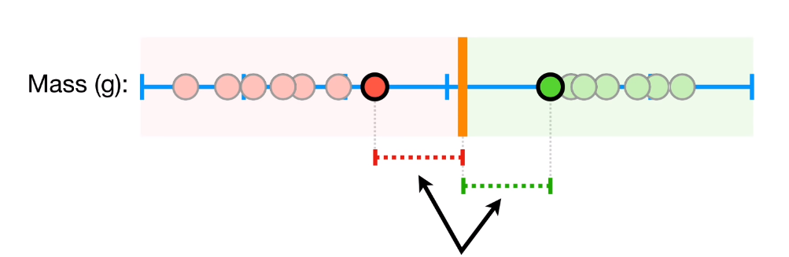


Support Vector Machines
Support vector
Support vector
Margin
Machine Learning Course
Abdel Rahman AlSabbagh

Slide 18
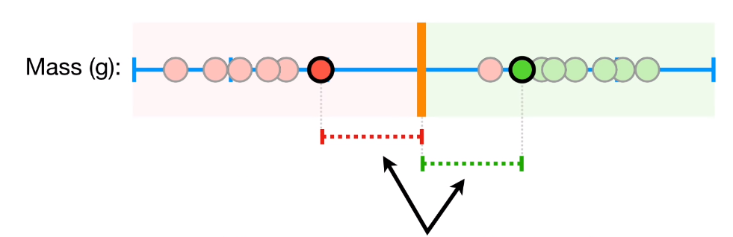
Support Vector Machines
Soft margin
Machine Learning Course
Abdel Rahman AlSabbagh

Slide 19
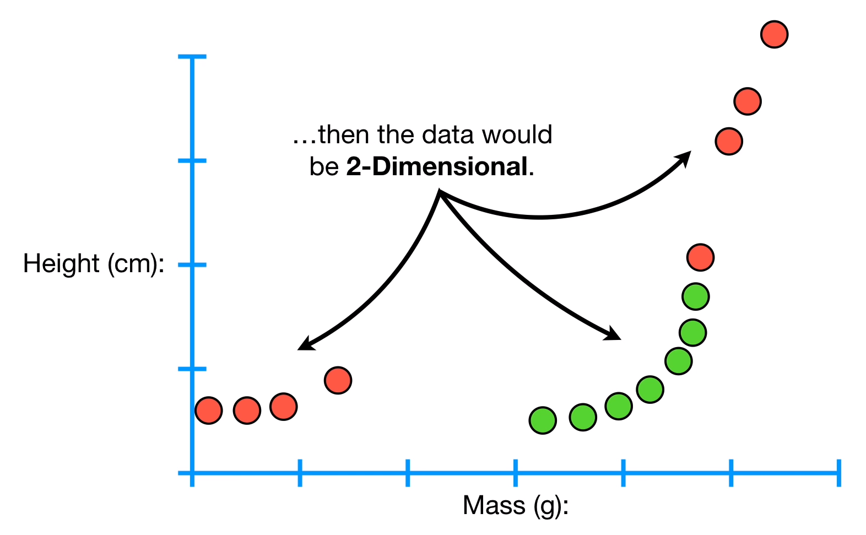

Support Vector Machines
Machine Learning Course
Abdel Rahman AlSabbagh

Slide 20
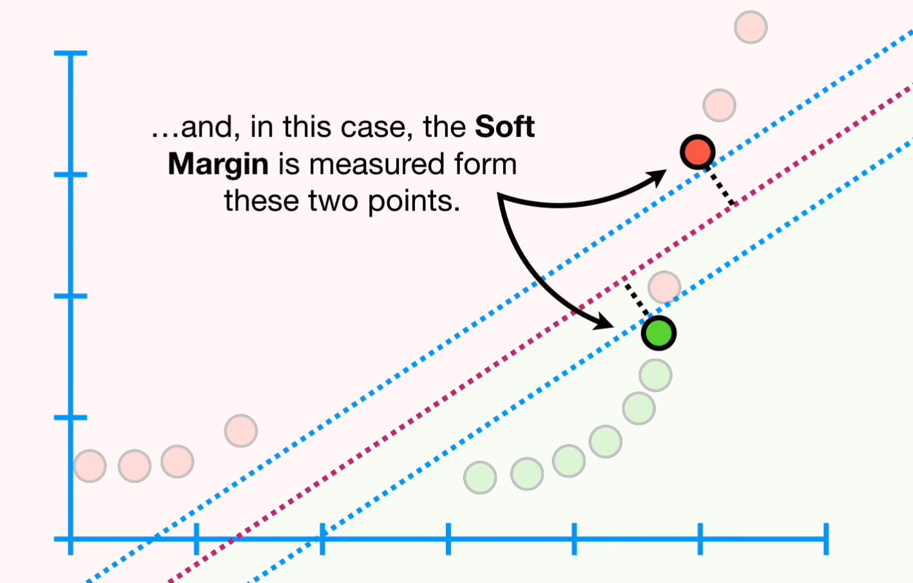
Support Vector Machines
Machine Learning Course
Abdel Rahman AlSabbagh

Slide 21
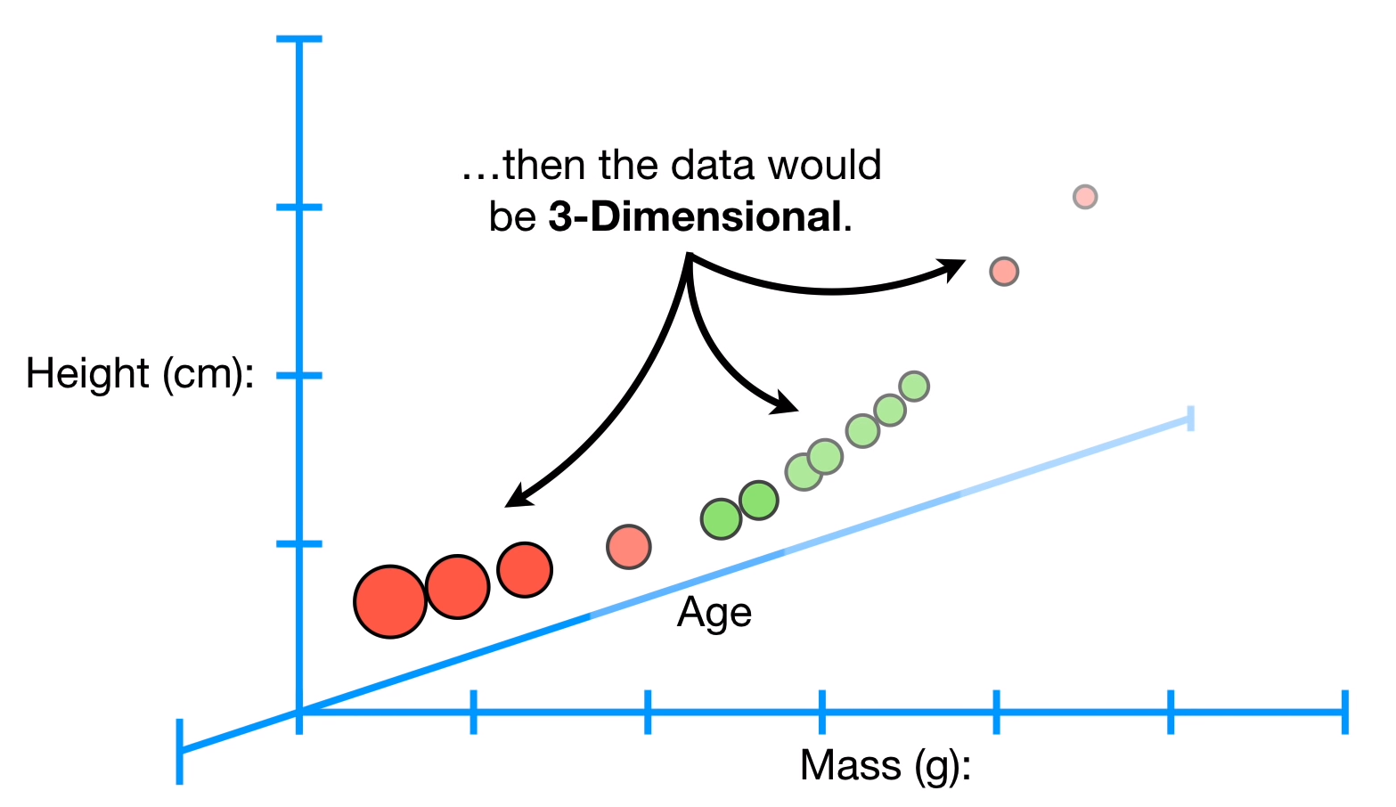
Support Vector Machines
Machine Learning Course
Abdel Rahman AlSabbagh

Slide 22
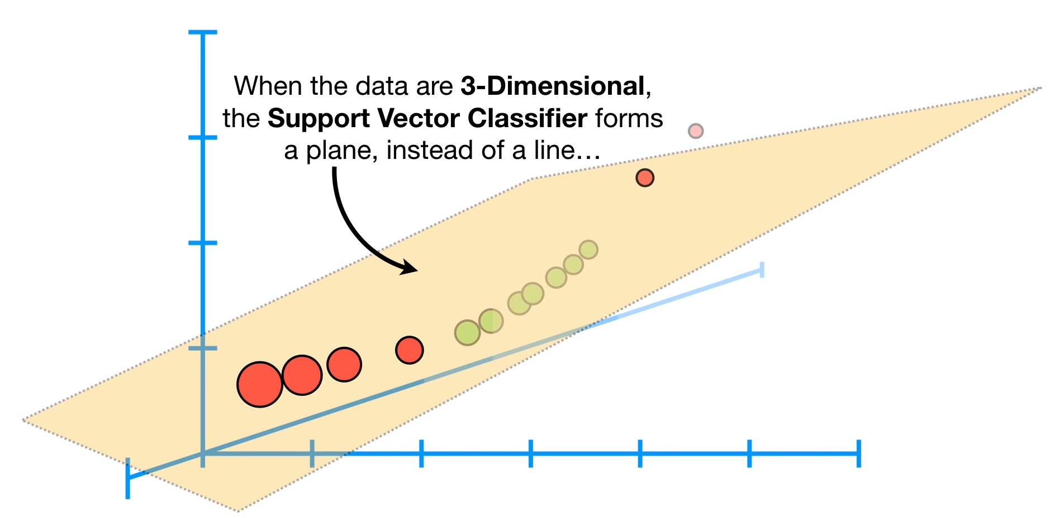

Support Vector Machines
Hyperplane
(flat subspace)
Machine Learning Course
Abdel Rahman AlSabbagh

Slide 23
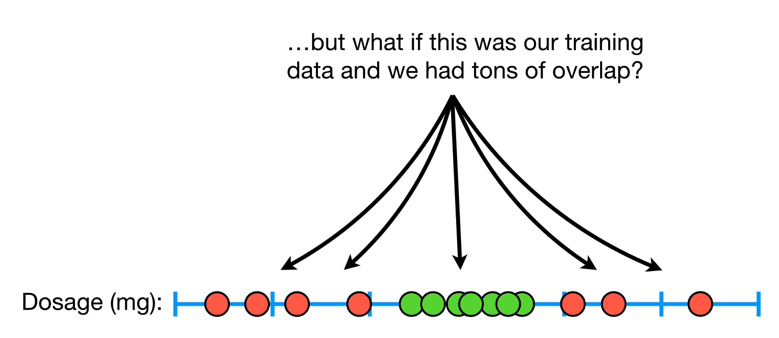
Support Vector Machines
Machine Learning Course
Abdel Rahman AlSabbagh

Slide 24
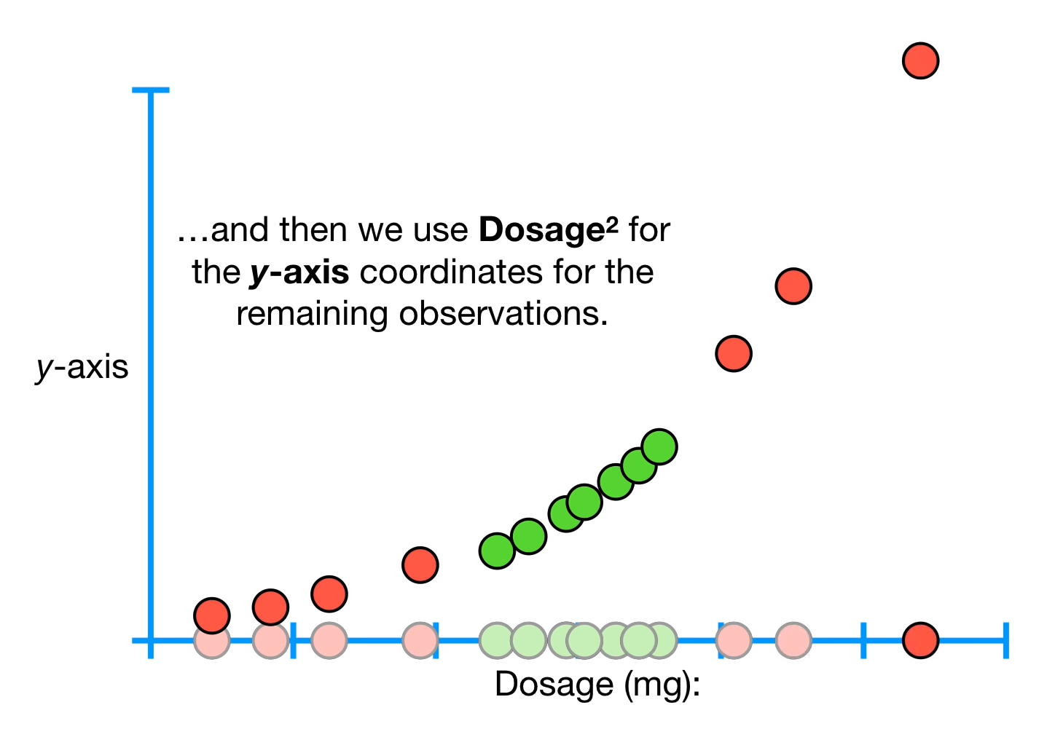
Support Vector Machines
Machine Learning Course
Abdel Rahman AlSabbagh

Slide 25
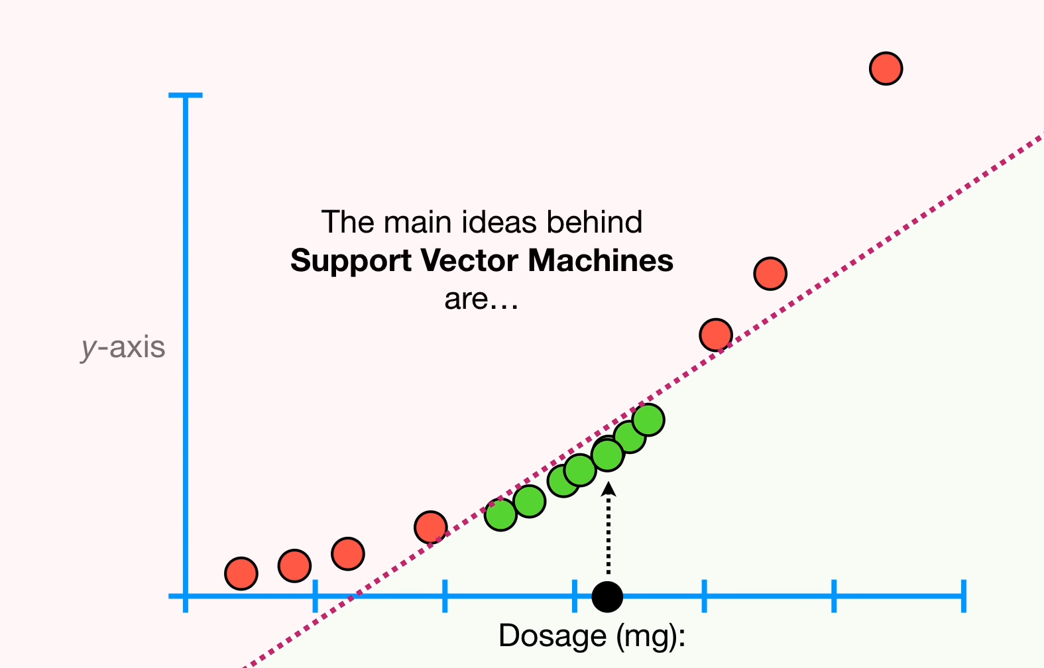

Support Vector Machines
Machine Learning Course
Abdel Rahman AlSabbagh

Slide 26
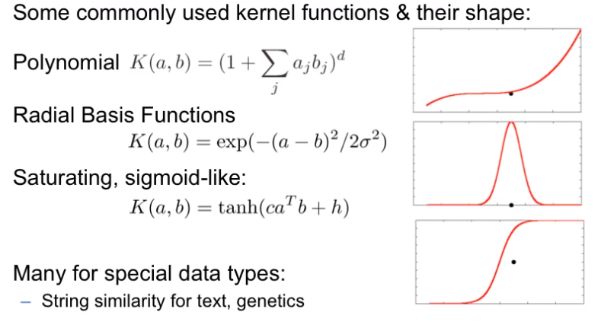
Kernal Functions in SVMs
Machine Learning Course
Abdel Rahman AlSabbagh

Slide 27



Tech Requirements
Polynomial Kernel Function
Machine Learning Course
Abdel Rahman AlSabbagh

Slide 28
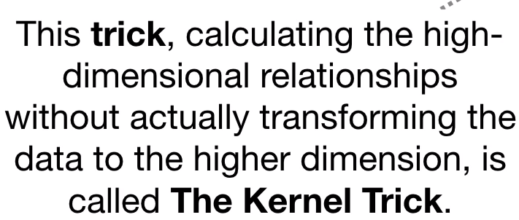
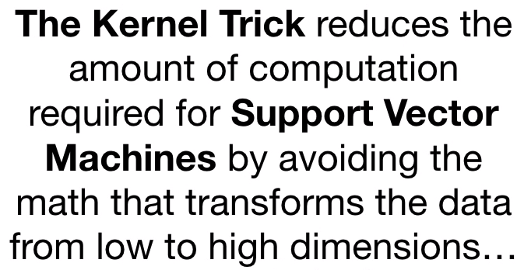
Tech Requirements
The Kernel Trick
Machine Learning Course
Abdel Rahman AlSabbagh

Slide 29
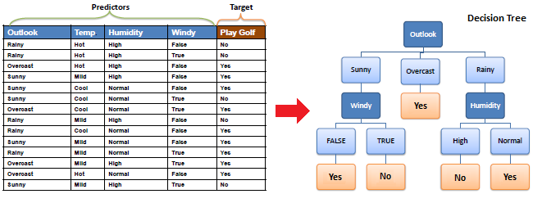
Tech Requirements
Decision Trees
Machine Learning Course
Abdel Rahman AlSabbagh

Slide 30

Tech Requirements
Random Forest
Machine Learning Course
Abdel Rahman AlSabbagh

Slide 31
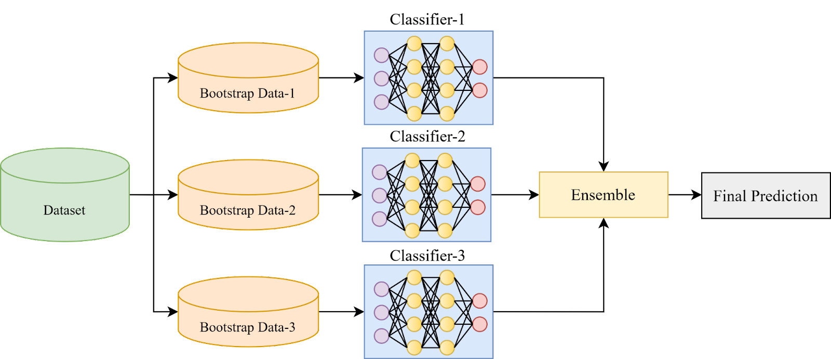
Tech Requirements
Ensemble Learning
Machine Learning Course
Abdel Rahman AlSabbagh

Slide 32
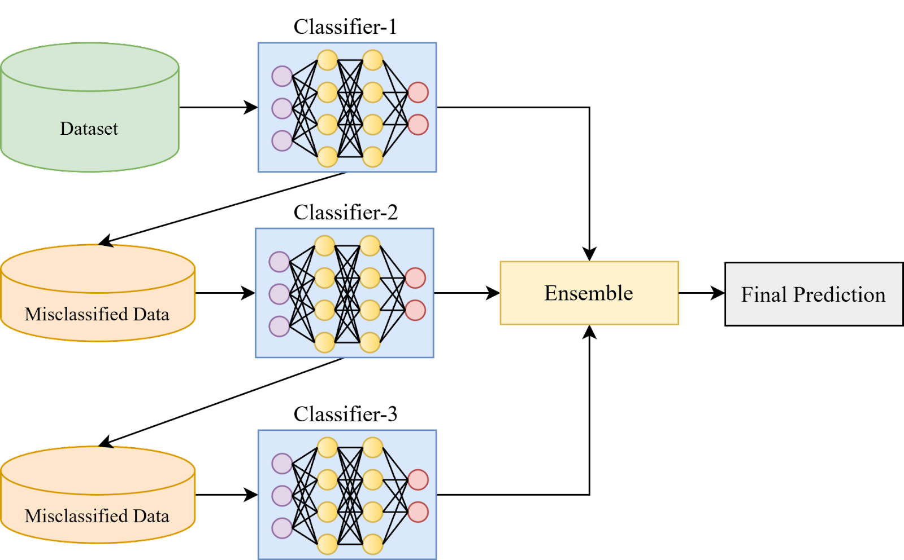
Tech Requirements
Ensemble Learning
Machine Learning Course
Abdel Rahman AlSabbagh

Slide 33
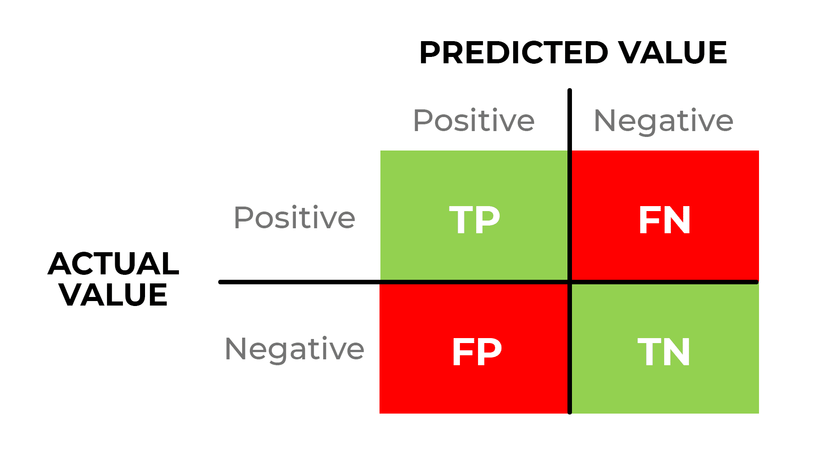
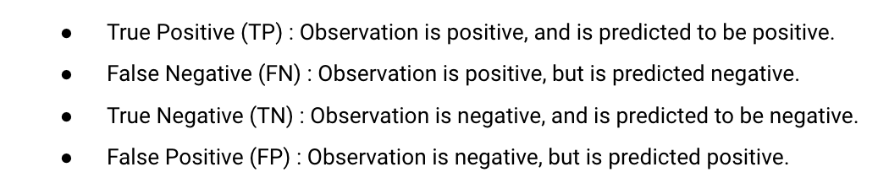
Tech Requirements
Evaluation Metrics for Classification Tasks
Confusion Matrix
Machine Learning Course
Abdel Rahman AlSabbagh

Slide 34
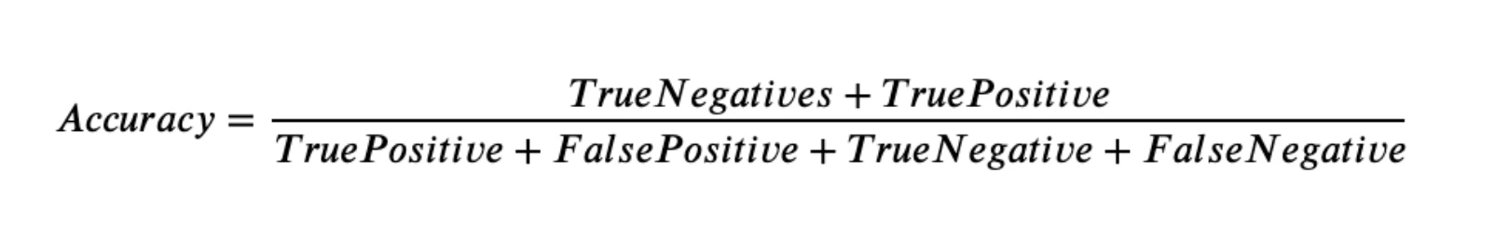
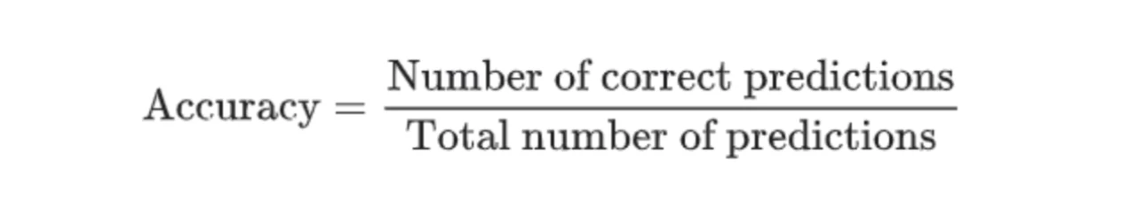
Tech Requirements
Evaluation Metrics for Classification Tasks
The proportion of True predictions on the total of predictions made.
Machine Learning Course
Abdel Rahman AlSabbagh

Slide 35
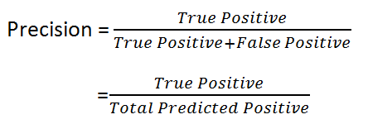
Tech Requirements
Evaluation Metrics for Classification Tasks
The proportion of True Positives among the total of Positive Predictions.
Machine Learning Course
Abdel Rahman AlSabbagh

Slide 36
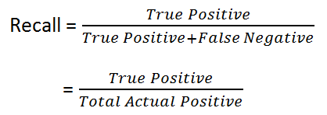
Tech Requirements
Evaluation Metrics for Classification Tasks
The proportion of True Positive among the total number of actual Positives.
Machine Learning Course
Abdel Rahman AlSabbagh

Slide 37
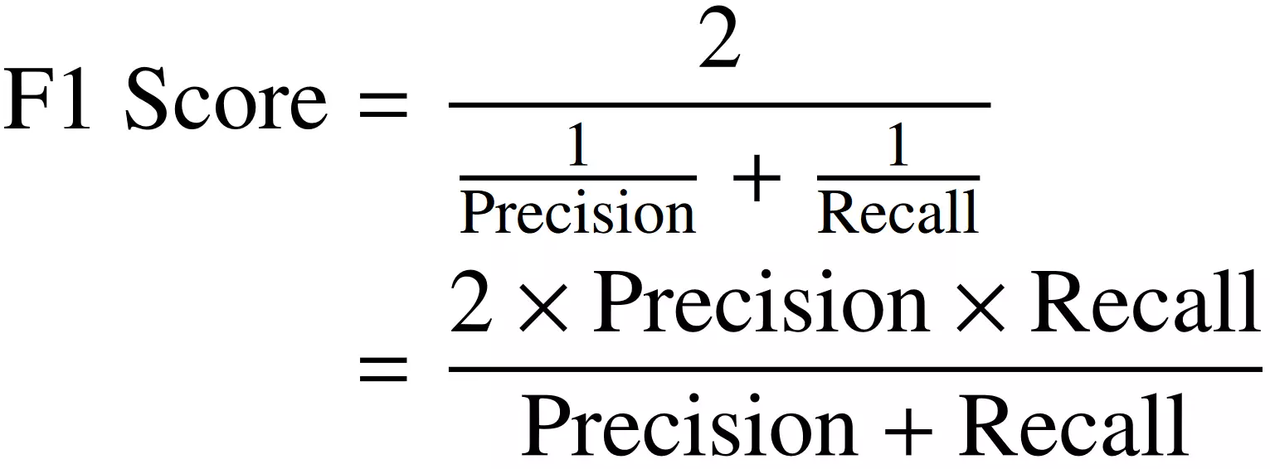
Tech Requirements
Evaluation Metrics for Classification Tasks
The harmonic mean of Precision and Recall.
Machine Learning Course
Abdel Rahman AlSabbagh

Slide 38
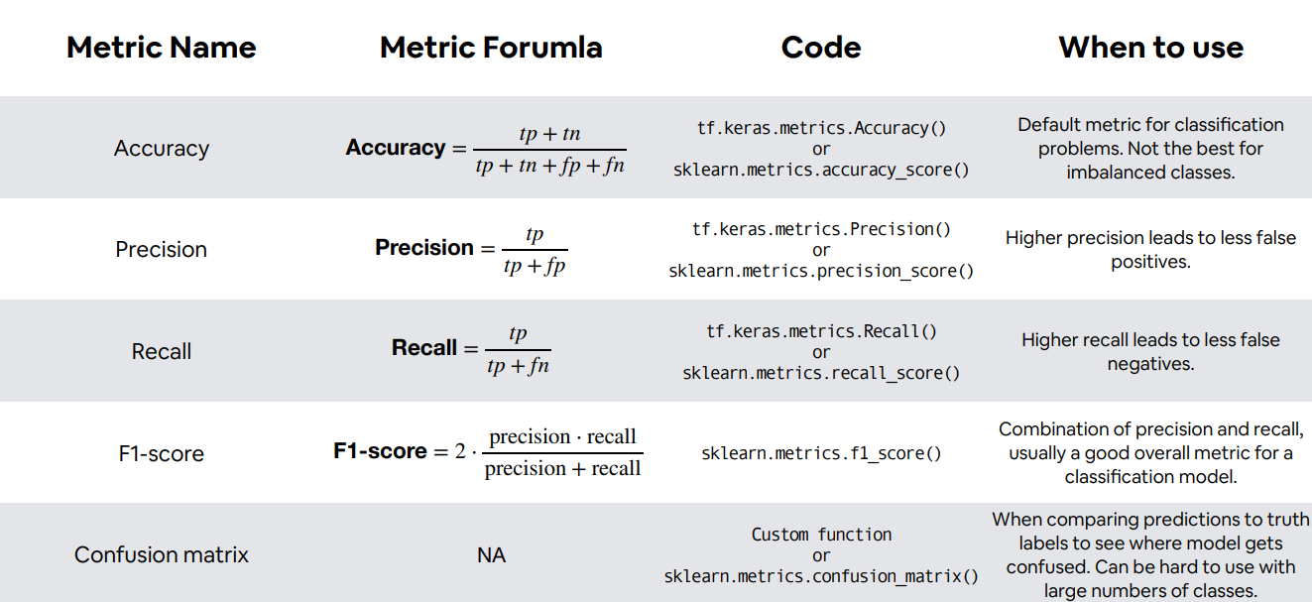
Tech Requirements
Evaluation Metrics for Classification Tasks
Machine Learning Course
Abdel Rahman AlSabbagh

Slide 39
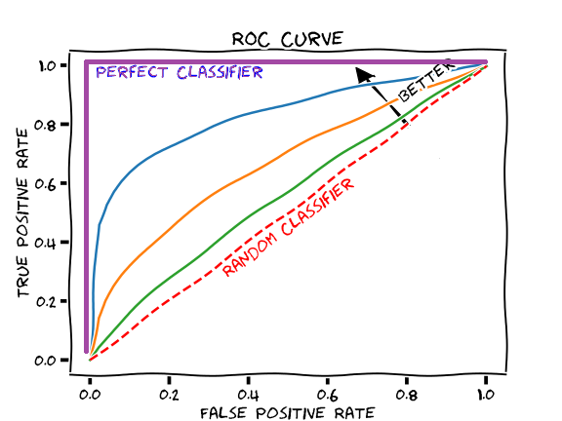
Tech Requirements
Evaluation Metrics for Classification Tasks
Machine Learning Course
Abdel Rahman AlSabbagh

Slide 40
Tech Requirements
We’re Almost Finished
Let’s code!
Machine Learning Course
Abdel Rahman AlSabbagh

Slide 41
Tech Requirements
Final Project
Document each of the following steps in your notebook.
Choose a dataset of your choice from Kaggle.com.
Preprocess the data acquired (clean it, normalize the data if needed, do feature engineering, etc…) and prepare it for the ML model. Explain every single step.
Make a comparison study between 3 types of models on the dataset used. Use different hyperparameters and features and try to obtain the highest results possible.
Get the results and analyze why certain models performed better that others.
Submit a .pynb file with data used.
Deadline: 1/6, 6 PM.
Good luck!
Machine Learning Course
Abdel Rahman AlSabbagh

Slide 42
Tech Requirements
Final Project
Use our colleague “Basel”’s tool to help you in your project:
https://clickml.streamlit.app/
Machine Learning Course
Abdel Rahman AlSabbagh

Slide 43

Tech Requirements
Final Project
I would also love to have your feedback of the course for the purpose of future improvements!
Machine Learning Course
Abdel Rahman AlSabbagh

Slide 44


Thank You
Wishing you all the best in your upcoming endeavors!
sabbagh@ieee.org
Connect on Linkedin

